Slide 1
Airline Management Project
Emre Çatalkaya

Slide 2
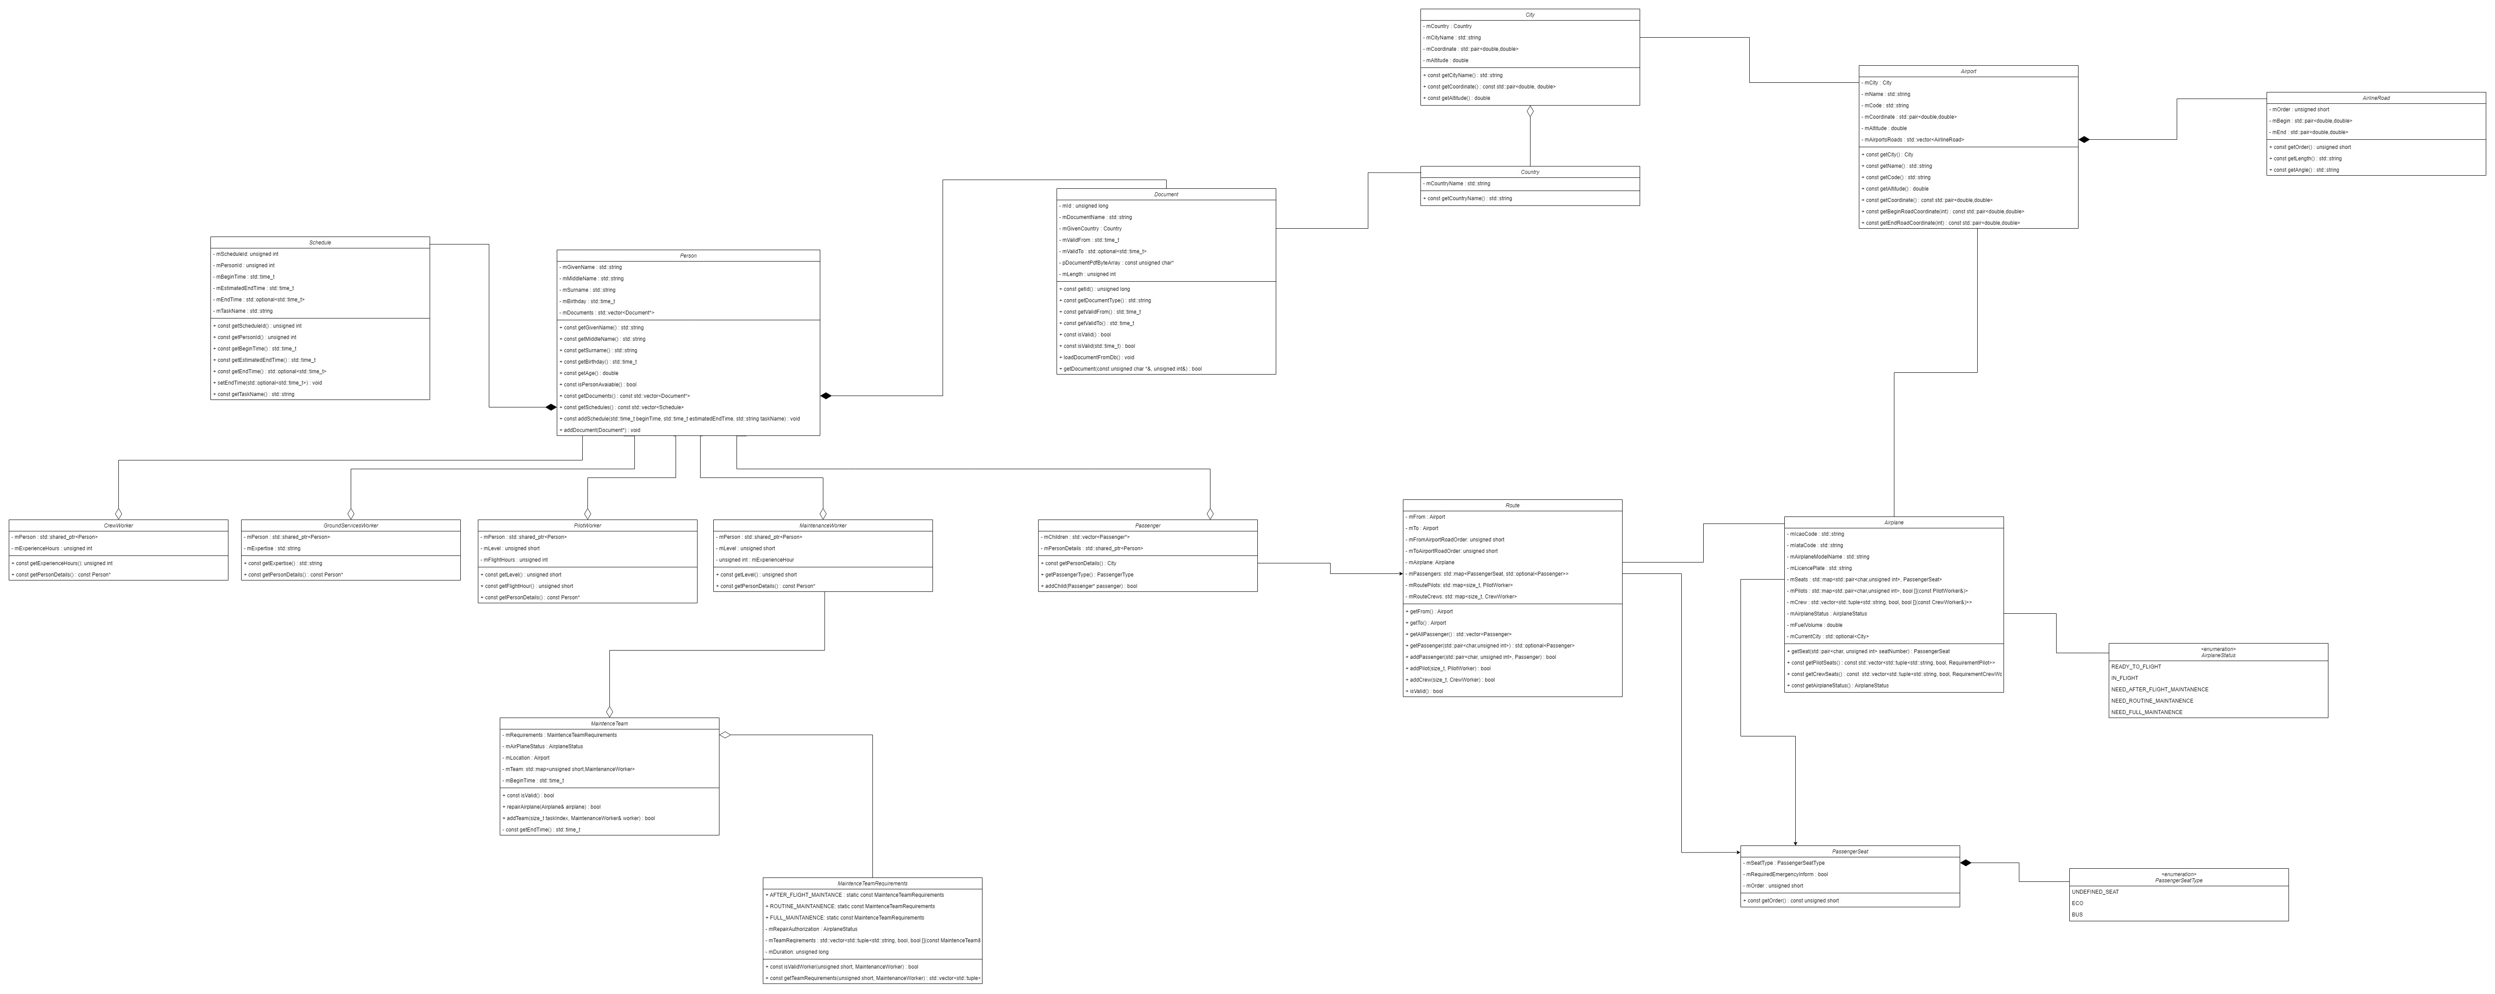

Slide 3
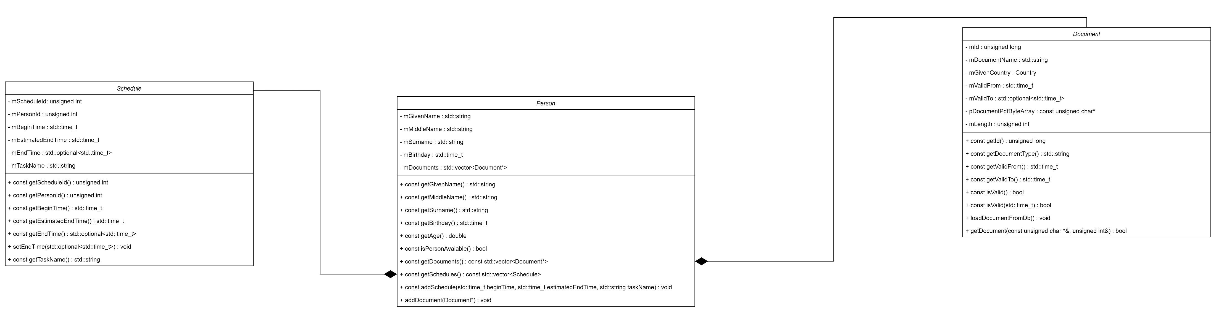
Person sınıfı yapısı

Slide 4
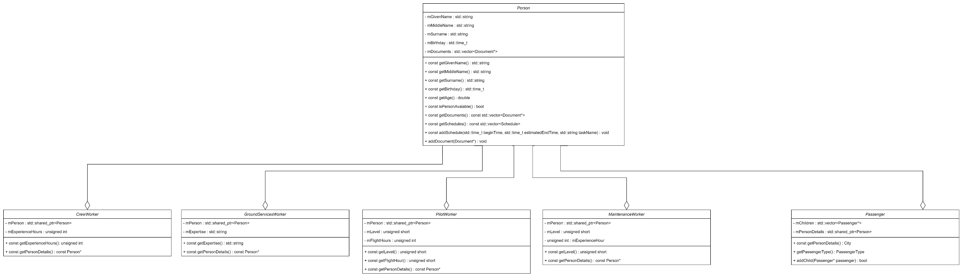
Person sınıfına bağlı sınıflar

Slide 5
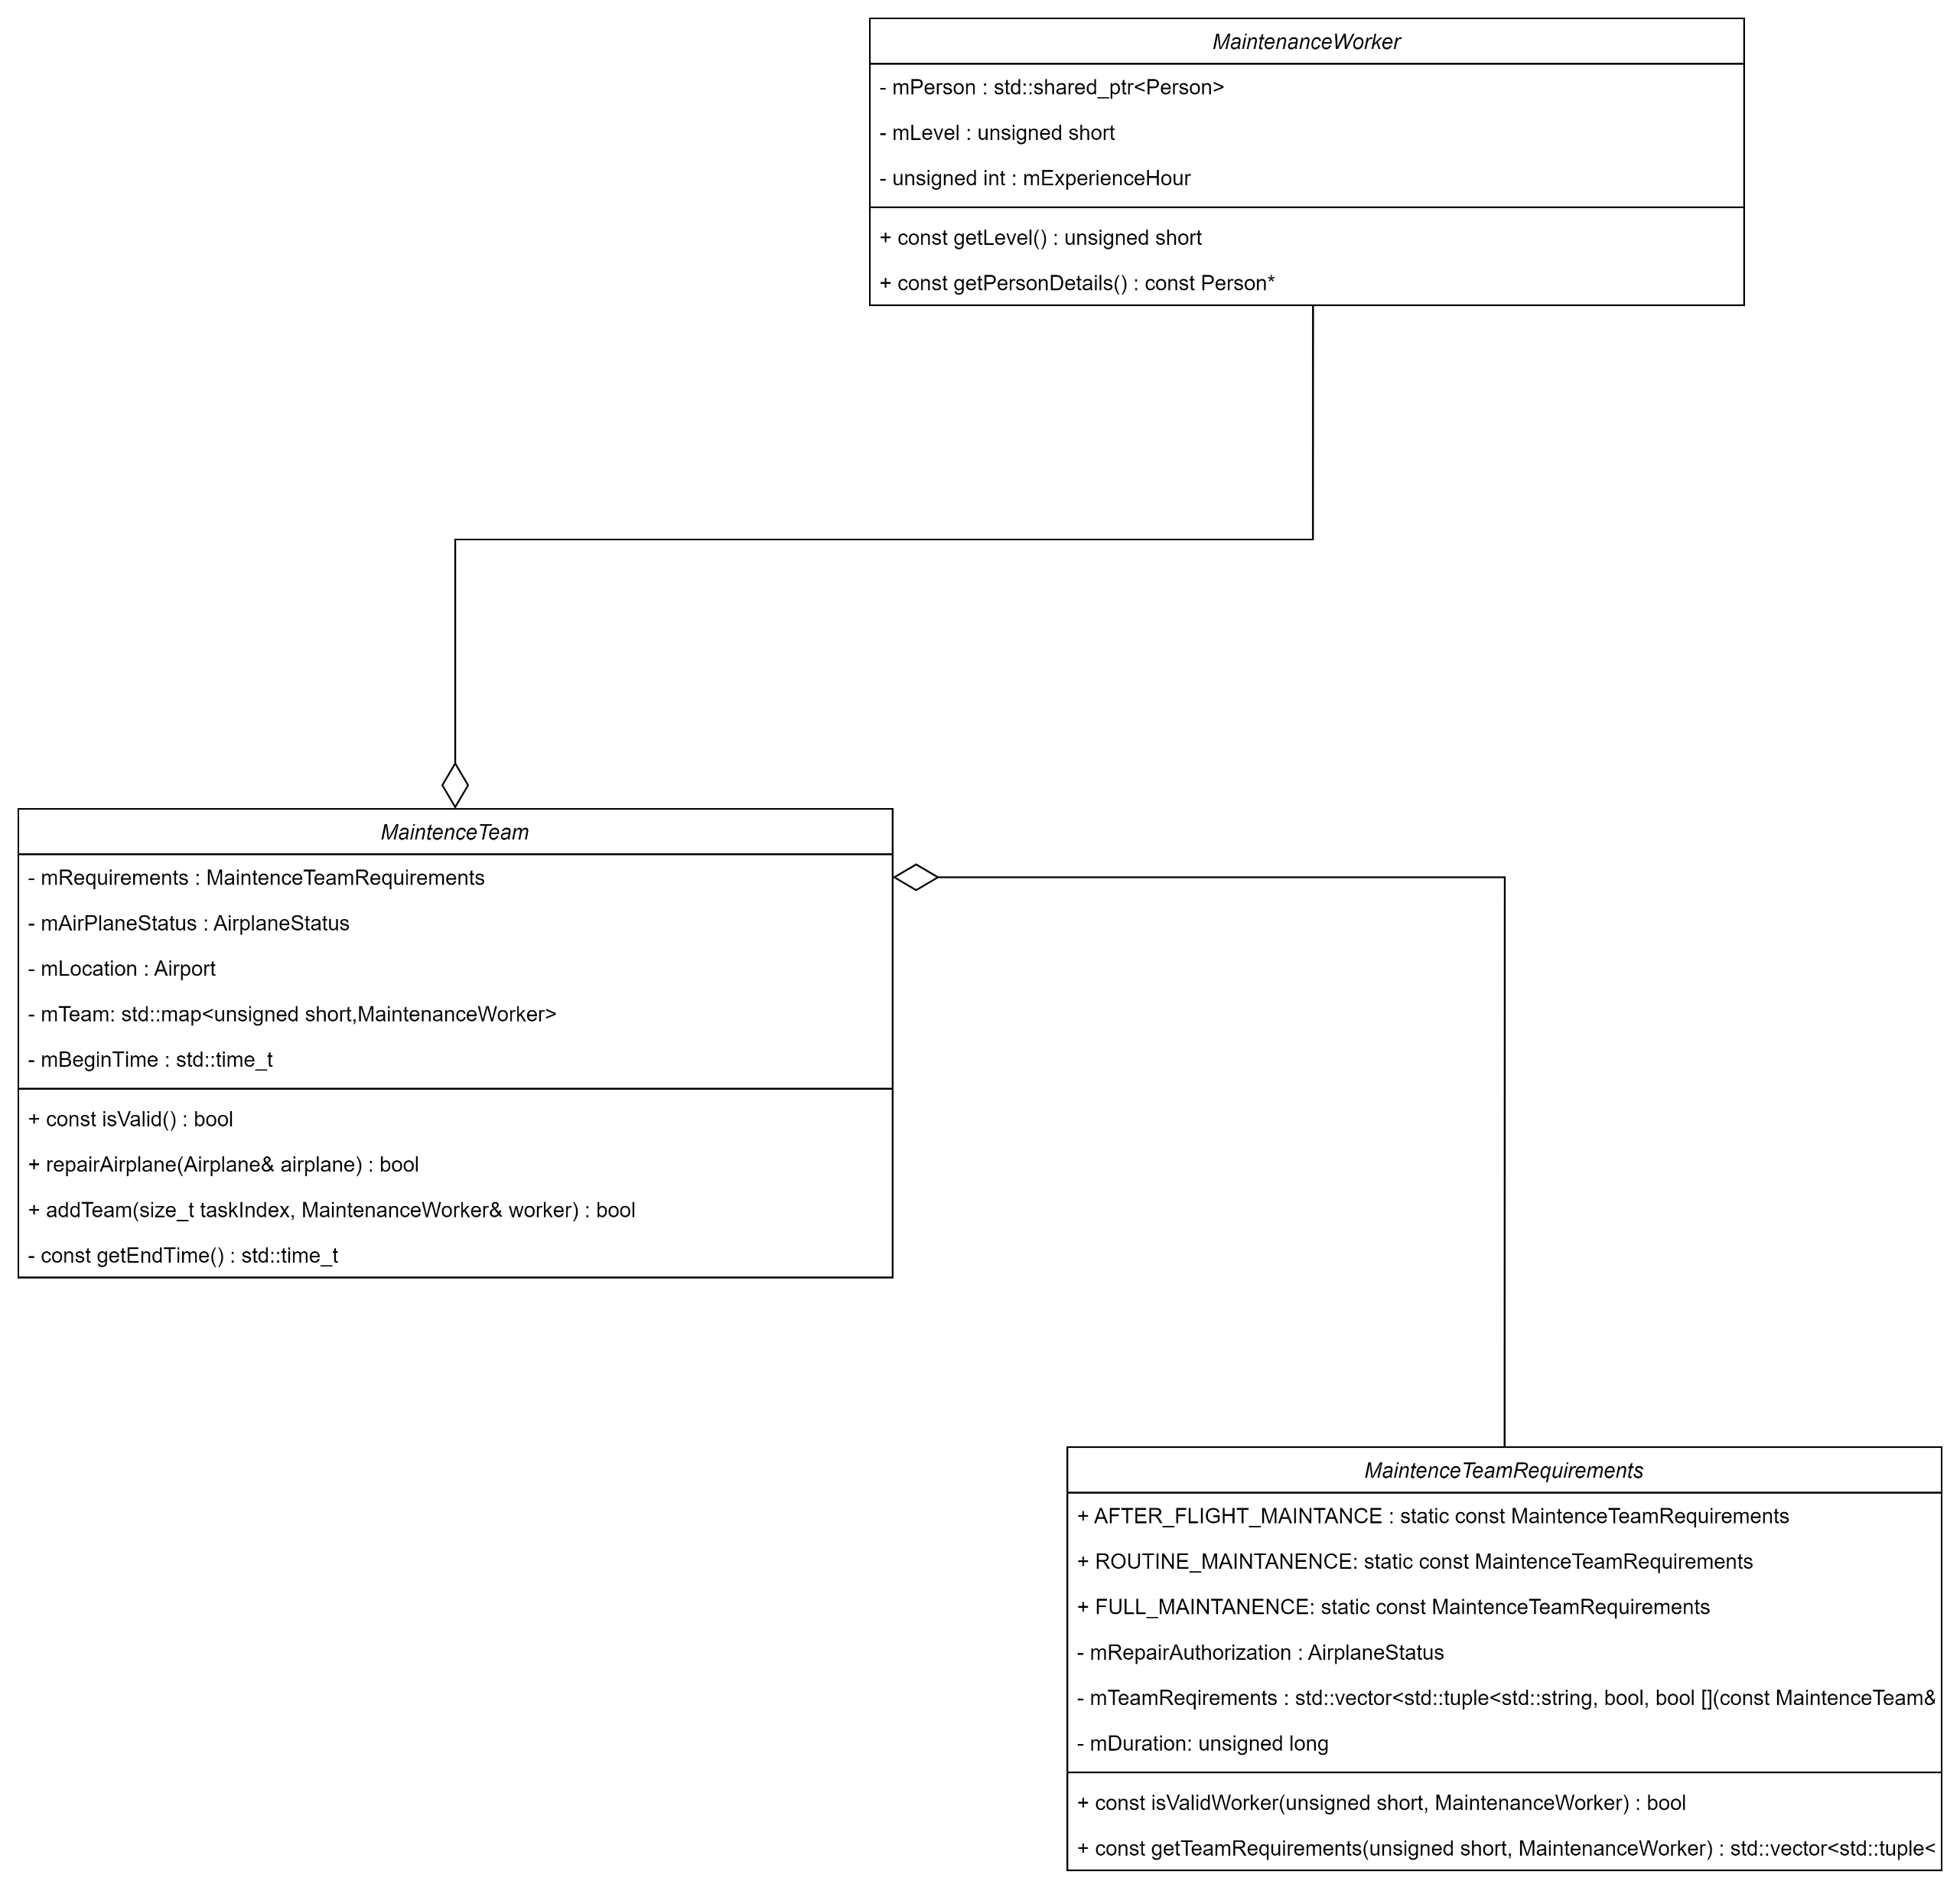
Maintainance Team sınıfı

Slide 6
Example of MaintanceTeamRequirement
Task Name
Requirement lambda function pointer
Is it mandatory
const MaintenceTeamRequirements MaintenceTeamRequirements::AFTER_FLIGHT_MAINTANCE = MaintenceTeamRequirements(
AirplaneStatus::NEED_AFTER_FLIGHT_MAINTANENCE,
std::vector<std::tuple<std::string, bool, RequirementTeam>>{
std::tuple<std::string, bool, RequirementTeam>("Team Leader", true, [](const MaintenanceWorker& worker, std::time_t beginTime) { return worker.getLevel() > 4 && worker->getPersonDetails()->isPersonAvaiable(mBeginTime, getEndTime()); }),
std::tuple<std::string, bool, RequirementTeam>("Senior Maintance Worker", true, [](const MaintenanceWorker& worker, std::time_t beginTime) { return worker.getLevel() > 3 && worker->getPersonDetails()->isPersonAvaiable(mBeginTime, getEndTime()); }),
std::tuple<std::string, bool, RequirementTeam>("Mid Maintance Worker", true, [](const MaintenanceWorker& worker, std::time_t beginTime) { return worker.getLevel() > 2 && worker->getPersonDetails()->isPersonAvaiable(mBeginTime, getEndTime()); }),
std::tuple<std::string, bool, RequirementTeam>("Mid Maintance Worker", false, [](const MaintenanceWorker& worker, std::time_t beginTime) { return worker.getLevel() > 2 && worker->getPersonDetails()->isPersonAvaiable(mBeginTime, getEndTime()); }),
std::tuple<std::string, bool, RequirementTeam>("Juniour Maintance Worker", true, [](const MaintenanceWorker& worker, std::time_t beginTime) { return worker.getLevel() > 1 && worker->getPersonDetails()->isPersonAvaiable(mBeginTime, getEndTime()); }),
std::tuple<std::string, bool, RequirementTeam>("Juniour Maintance Worker", true, [](const MaintenanceWorker& worker, std::time_t beginTime) { return worker.getLevel() > 1 && worker->getPersonDetails()->isPersonAvaiable(mBeginTime, getEndTime()); }),
std::tuple<std::string, bool, RequirementTeam>("Juniour Maintance Worker", true, [](const MaintenanceWorker& worker, std::time_t beginTime) { return worker.getLevel() > 1 && worker->getPersonDetails()->isPersonAvaiable(mBeginTime, getEndTime()); }),
std::tuple<std::string, bool, RequirementTeam>("Juniour Maintance Worker", false, [](const MaintenanceWorker& worker, std::time_t beginTime) { return worker.getLevel() > 1 && worker->getPersonDetails()->isPersonAvaiable(mBeginTime, getEndTime()); }),
std::tuple<std::string, bool, RequirementTeam>("Juniour Maintance Worker", false, [](const MaintenanceWorker& worker, std::time_t beginTime) { return worker.getLevel() > 1 && worker->getPersonDetails()->isPersonAvaiable(mBeginTime, getEndTime()); }),
std::tuple<std::string, bool, RequirementTeam>("Intern Maintance Worker", false, [](const MaintenanceWorker& worker, std::time_t beginTime) { return worker.getLevel() == 1 && worker.getPersonDetails()->getAge() < 30; }),
std::tuple<std::string, bool, RequirementTeam>("Intern Maintance Worker", false, [](const MaintenanceWorker& worker, std::time_t beginTime) { return worker.getLevel() == 1 && worker.getPersonDetails()->getAge() < 30; }),
std::tuple<std::string, bool, RequirementTeam>("Intern Maintance Worker", false, [](const MaintenanceWorker& worker, std::time_t beginTime) { return worker.getLevel() == 1 && worker.getPersonDetails()->getAge() < 30; }),
std::tuple<std::string, bool, RequirementTeam>("Intern Maintance Worker", false, [](const MaintenanceWorker& worker, std::time_t beginTime) { return worker.getLevel() == 1 && worker.getPersonDetails()->getAge() < 30; }),
std::tuple<std::string, bool, RequirementTeam>("Intern Maintance Worker", false, [](const MaintenanceWorker& worker, std::time_t beginTime) { return worker.getLevel() == 1 && worker.getPersonDetails()->getAge() < 30; }),
std::tuple<std::string, bool, RequirementTeam>("Intern Maintance Worker", false, [](const MaintenanceWorker& worker, std::time_t beginTime) { return worker.getLevel() == 1 && worker.getPersonDetails()->getAge() < 30; }),
});

Slide 7
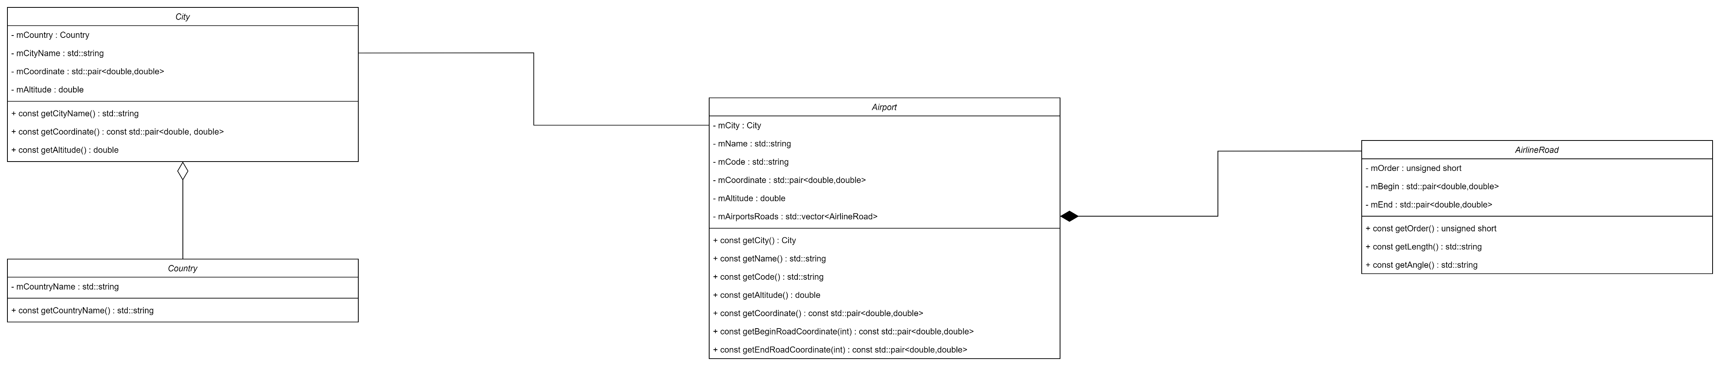
Airport

Slide 8
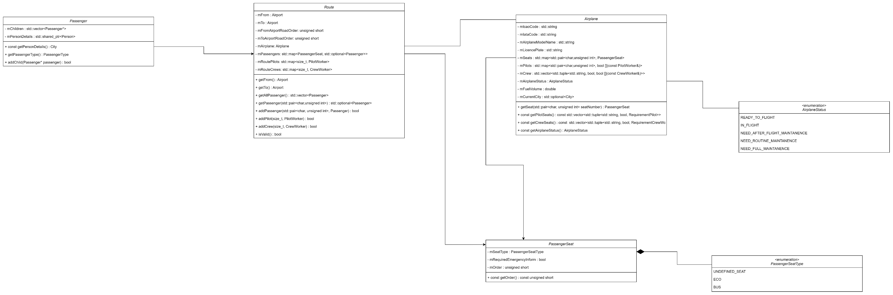
Airplane

Slide 9
Git repository
https://github.com/avemphract/airline-management/tree/master

